Slide 1

Body Temperature Homeostasis
Thermoregulation
Chapter 7 Human Perspectives

Slide 2

Thermoregulation
Regulation of core body temperature at 36.8ºC
Temperature where chemical reactions in cells are stable and optimised.
Homeostatic mechanisms do this.
Balance between heat production and heat loss.
If body temp too high:
Proteins denature
Nerve cells do not function correctly
Chemical reactions are uncontrolled
DEATH
If body temp too low:
Cellular reactions too slow
DEATH

Slide 3
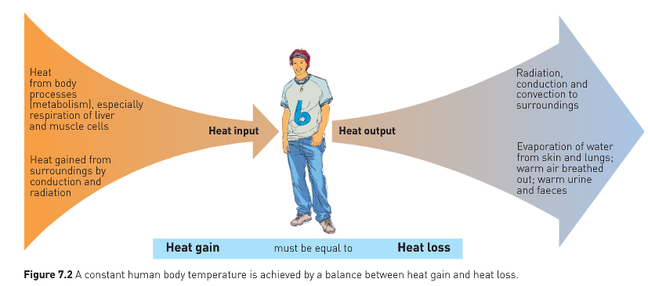

Slide 4

Heat Production
During cellular respiration (metabolism)
When metabolic rate increases, heat production increases.
Eg during Exercise:
Muscles need energy to contract
Cells respire more
More heat produced
Body heat rises
Things that can increase metabolic rate and body heat include:
Exercise
Stress
Sympathetic NS stimulation

Slide 5
Temperature receptors (thermoreceptors)
Peripheral thermoreceptors:
In skin and other surface tissues
Detect temperature of external environment
Cold receptors
Heat receptors
Send signals to hypothalamus, which then acts to regulate body temperature
Central thermoreceptors
In hypothalamus, spinal cord, abdominal organs
Send signals to hypothalamus, which then acts to regulate body temperature

Slide 6
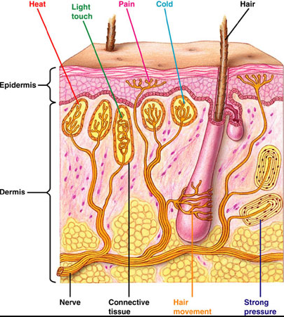

Slide 7
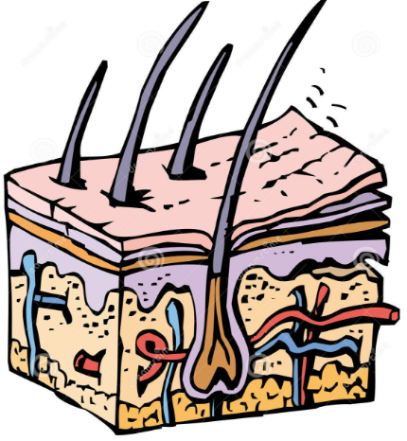
Skin and temperature regulation
Large surface area for heat exchange
Conduction
Convection
Radiation
Blood vessels help exchange heat between external and internal environments
Diameter of blood vessels can be controlled to increase or decrease this exchange
Sweat glands in skin produce sweat
Evaporative cooling!
Note: evaporation from lungs also causes heat loss

Slide 8
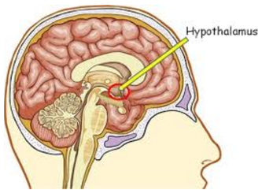
Preventing body temp from falling
thermoreceptors in skin send message that skin is cold to hypothalamus via sensory nerves

Slide 9
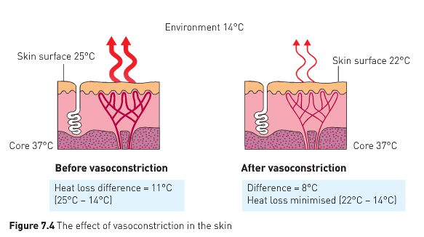
Hypothalamic responses to falling temperature
Vasoconstriction
Sympathetic stimulation from hypothalamus causes blood vessels to constrict
Decreases flow of warm blood to skin, so less heat exchange

Slide 10
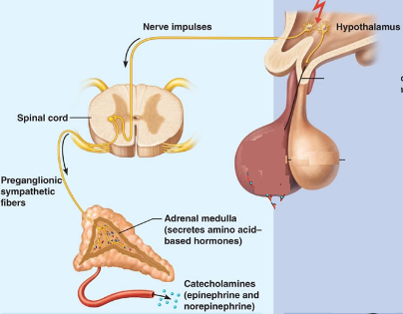
Hypothalamic responses to falling temperature
Sympathetic NS stimulation of adrenal medulla
Adrenalin and Noradrenalin release
Increase in cellular metabolism and heat production
Counteracts heat loss

Slide 11
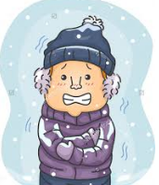
Hypothalamic responses to falling temperature
Shivering
Hypothalamus sends message to brain centres that control skeletal muscle tone
Results in shivering – quick, repeated contraction of muscles
Heat is released from muscles
Can be influenced by conscious thought from cerebral cortex

Slide 12
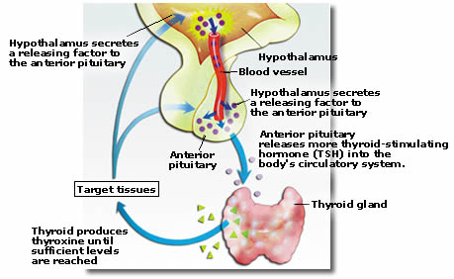
Hypothalamic responses to falling temperature
Increase in thyroxine production
Hypothalamus sends message to anterior pituitary
TSH (Thyroid Stimulating Hormone) released
Stimulates Thyroid
Thyroxine released
Increases metabolic rate and therefore heat.

Slide 13
Behavioural responses to falling temperature
Conscious awareness of feeling cold leads to behavioural changes to minimise heat loss:
Seeking shelter from wind/rain/cold weather
Putting on clothing to insulate against heat loss
Curling up to decrease surface area for heat loss

Slide 14
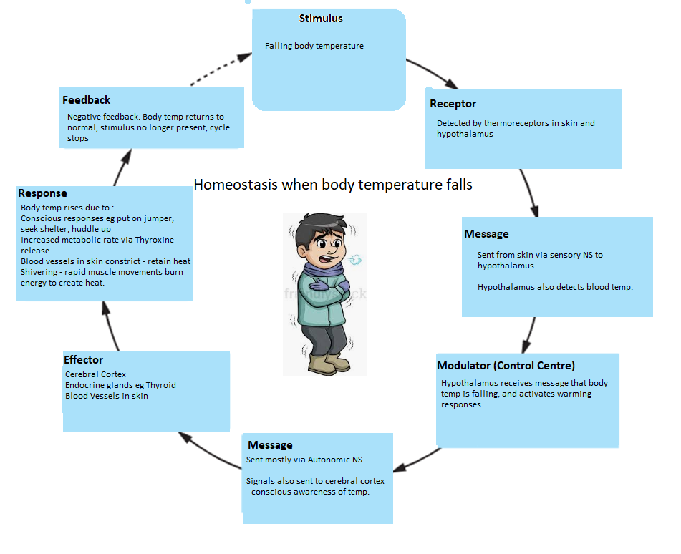

Slide 15
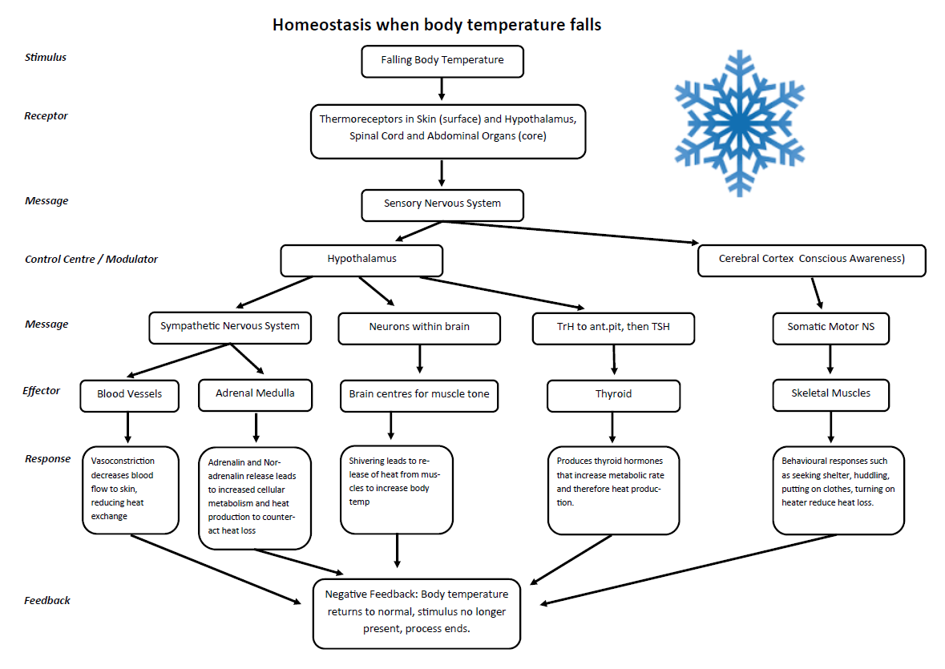

Slide 16
Preventing body temp from rising
Heat receptors in skin send message to hypothalamus via sensory nerves
Most heat is lost through the skin, some lost via lungs and urine/faeces

Slide 17
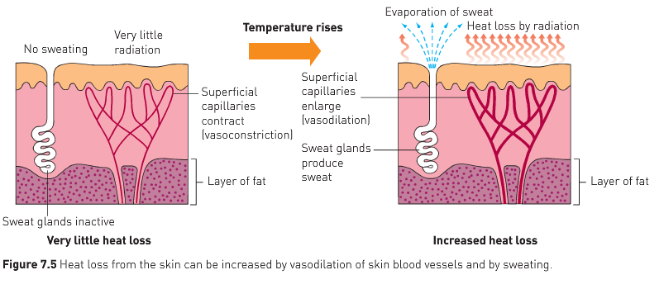
Hypothalamic responses to rising temperature
Vasodilation
Blood vessels in skin dilate
More blood can move through
Allows heat to be lost to surrounding environment

Slide 18
Hypothalamic responses to rising temperature
Sweating
Needed for environmental temps above 28ºC
Only option for cooling if environ above 37ºC
Evaporation of liquid from skin accelerates heat transfer from body to environment
Works better in low humidity
Longer term…
Decrease in metabolic rate due to reduced thyroxine

Slide 19
Behavioural responses to rising temperature
Conscious awareness of feeling too hot leads to behavioural changes to allow cooling:
Wearing fewer clothing layers
Seeking cooler environments
Reducing physical activity

Slide 20
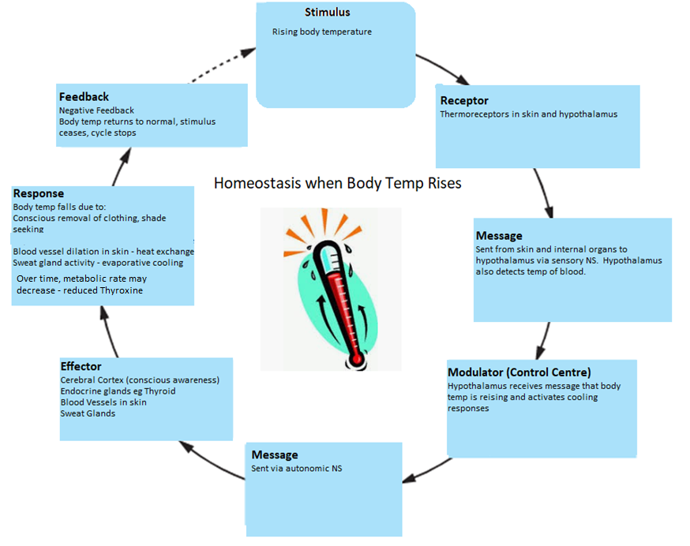

Slide 21
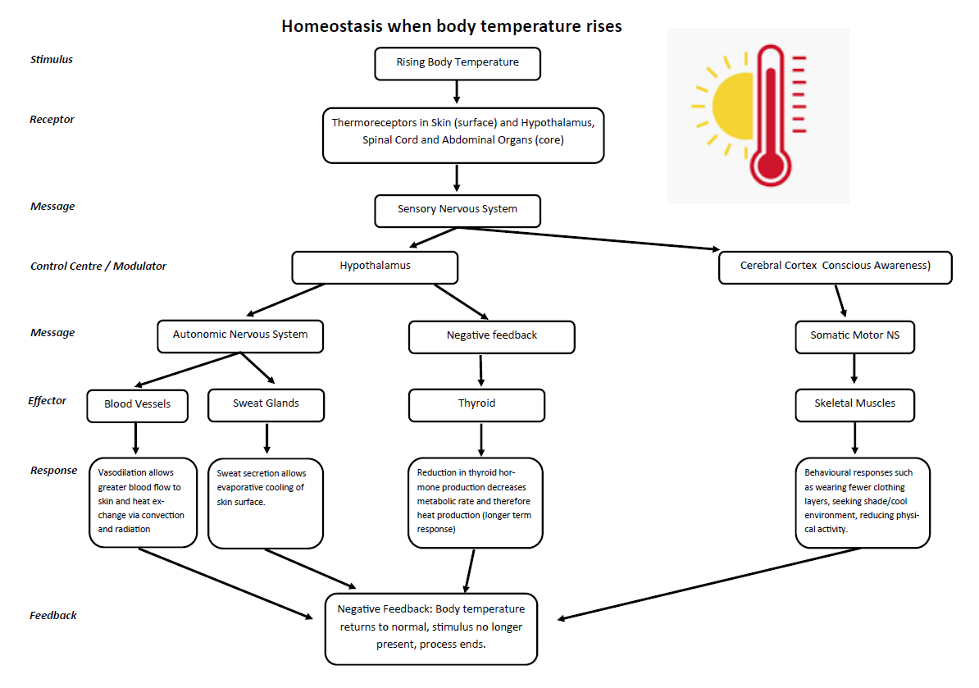

Slide 22
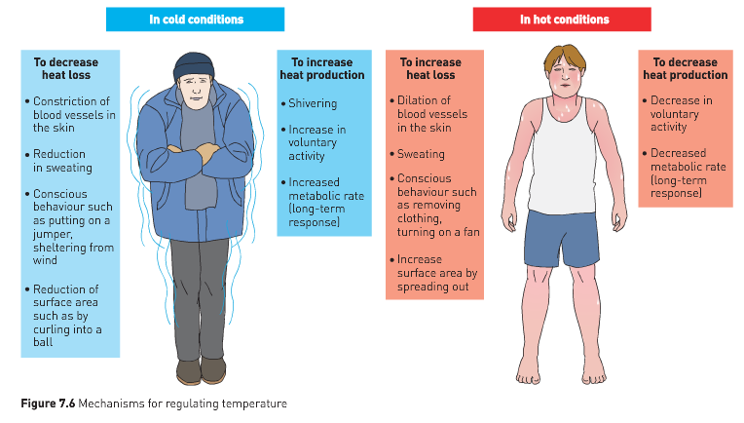

Slide 23
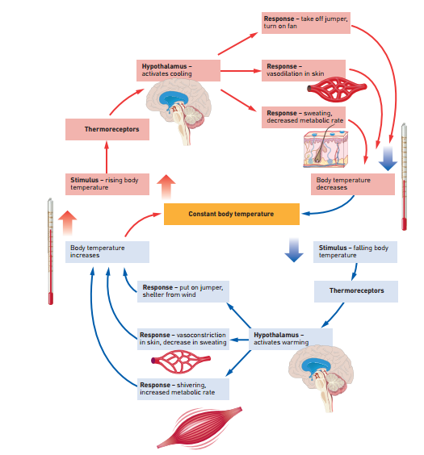

Slide 24
Temperature Tolerance
Core body temp above 42ºC is dangerous and will result in death if prolonged.
Heat stroke:
when the body is unable to manage temperature due to extreme external conditions
Treatment – careful cooling
Heat exhaustion:
Less severe
Dehydration from sweating → collapse
Hypothermia:
Temps below 32ºC.
Death if prolonged

